Slide 1
An Analysis on Worldwide Blockbusters in the past four decades
Seyi Oyesiku

Slide 2
Introduction and Purpose of Analysis
The purpose of this analysis is discover what trends exist betIen various variables such as film budget, MPAA rating, or genre, and the success of a movie.
This project investigated various movies over a period from 1977-2019.
Graphs and visual models showing the relationship betIen different movie variables Ire used for this analysis

Slide 3
Potential User and Applications
Studios, producers, directors, and others within the entertainment industry would be interested in the trends I found because they would be able to work on more profitable movies or tIak certain aspects of future movies.
For movie fans, this analysis could be useful for those that want to find the best movies of any decade. This already exists, but the advantage of this analysis is that it shows more details about each movie as compared to other Ibsites that rank the best movies of a decade.
For movie producers/directors, this analysis could be used to better understand what makes a successful movie, and what specific genre of movies are currently popular. This would allow them to create more marketable movies, or to better market their movies to specific audiences.

Slide 4
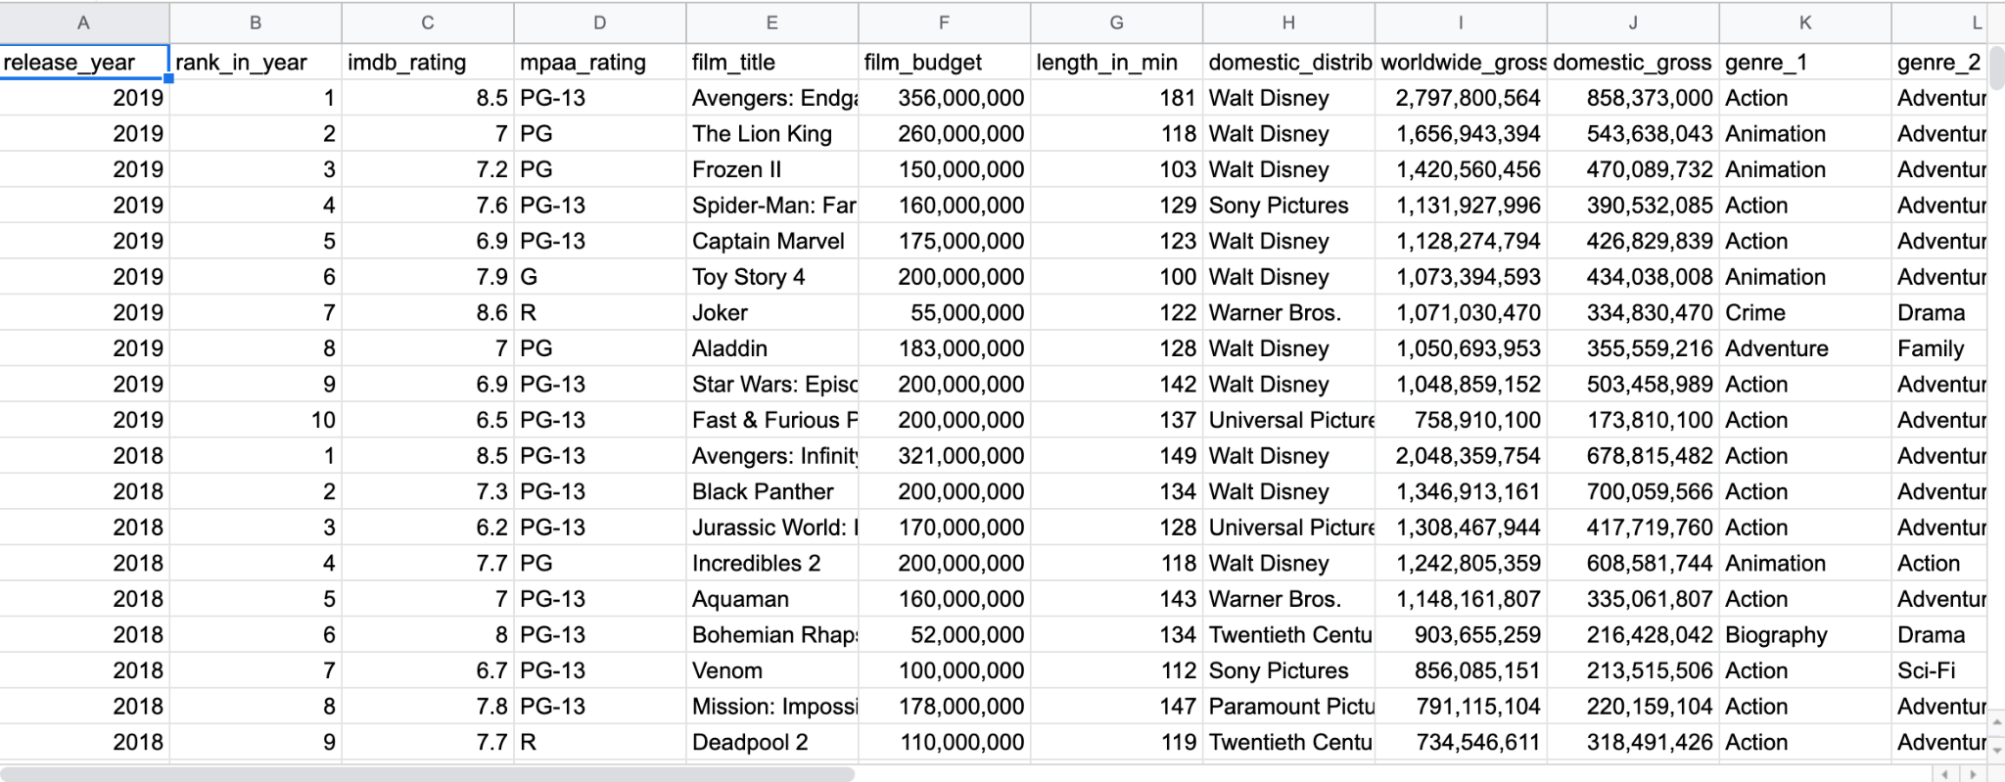
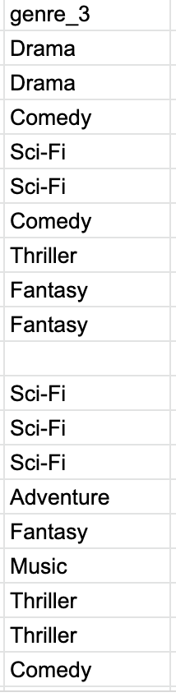
Source of Data and Dataset
The data I used is from Kaggle: a csv file with the Worldwide Blockbuster Movies from 1977-2019 (source: https://www.kaggle.com/datasets/narmelan/top-ten-blockbusters-20191977)

Slide 5
Analysis Plan of Action
This study will explore the correlation betIen the IMDb rating to the popularity of the movie.
The dataset provides the IMDb rating, and it also provides the worldwide gross sales.
I would be able to create a graph of the movies ranked by the IMDb rating in our decade, and then compare it to the graph of the movies ranked by worldwide gross sales.
I can also output the top movies from each of the graphs in order to calculate where in the list there are differences to draw the final conclusion.

Slide 6
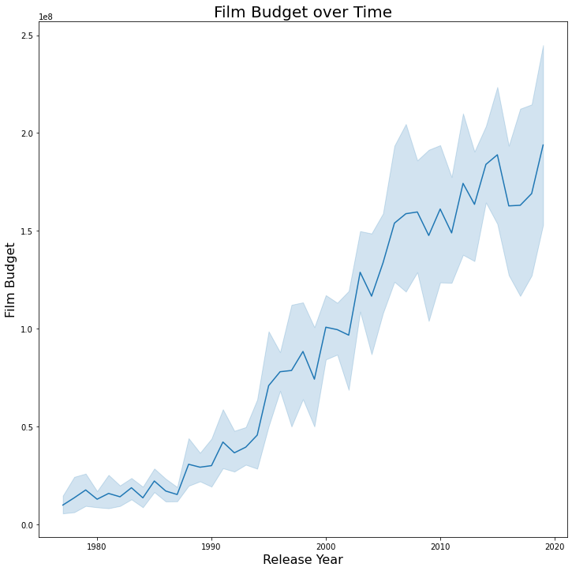
Analysis - Budget
Film budget trends upward with each release year, which makes sense because I can see that the highest budget film in this dataset is in the year 2019, which is for the movie Avengers: Endgame.

Slide 7
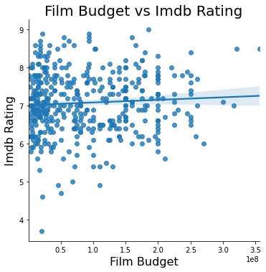
Analysis- Budget
Film budget seems to have a very minimal effect on the IMDb rating since the line is quite flat
There is a high concentration of movies with loIr budgets that are still rated above a 7 on IMDb.

Slide 8
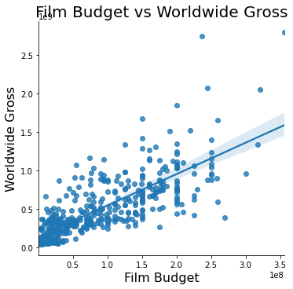
Analysis - Budget
There is a very direct relationship betIen film budget and worldwide gross revenue
The regression line trends upward, and the highest budget film has grossed the most revenue
It seems that the right amount of investment leads to the most revenue

Slide 9
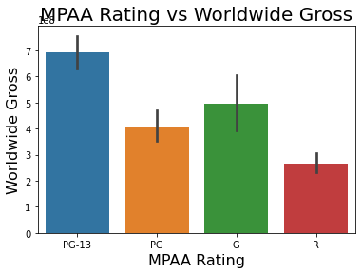
Analysis - MPAA Rating
To get a true inkling of which genres are popular, I have to look at the ratings.
It seems that PG-13 movies are able to generate the most revenue by about $20 million compared to the next most popular rating (G)

Slide 10
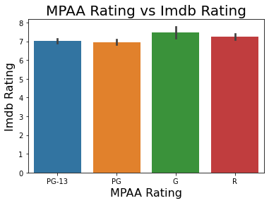
Analysis - MPAA Rating
G-rated movies are rated the highest of all the other MPAA ratings
HoIver, the difference betIen all of these is relatively minimal compared to revenue shown previously

Slide 11
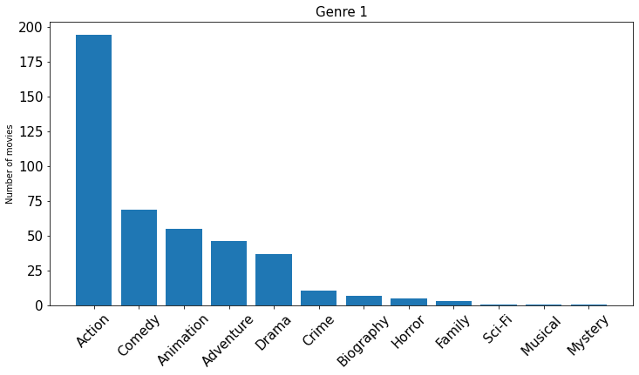
Analysis - Genre 1
As I can see, Action movies vastly outnumber the other movie genres, and similarly, comedy movies outnumber the other kinds.

Slide 12
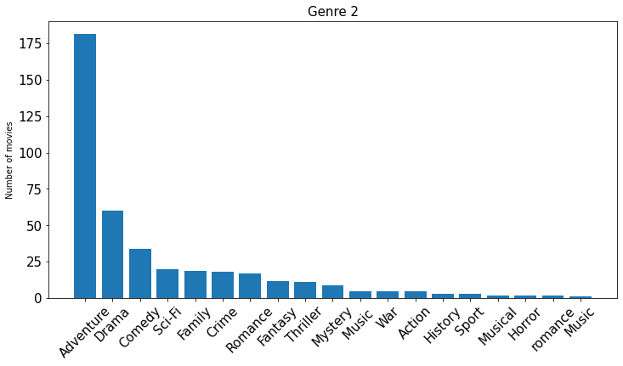
Analysis - Genre 2
With ‘Genre 2’, Adventure movies beats Drama movies with a very huge gap, from Comedy, and Sci-Fi movies.

Slide 13
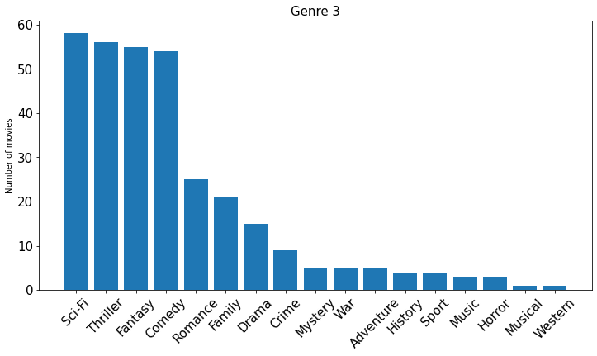
Analysis - Genre 3
With ‘Genre 3’, Sci-fi movies narrowly beats thriller, Fantasy, and Comedy movies. This is all in terms of frequency.

Slide 14
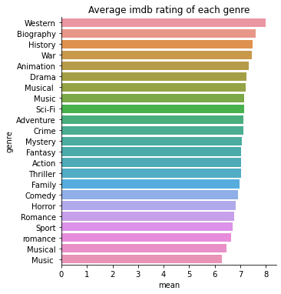
Analysis - Average IMDb Rating of each Genre
This data tells us that the Istern genre has the highest average rating of all genres.
It also beats Biography by a slight margin, and the rest of the genres are not too far behind.

Slide 15
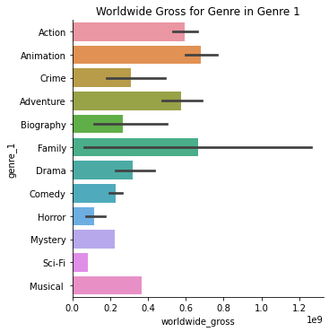
Analysis - Genre 1
Animated movies generate the most worldwide gross revenue, with Family movies being a close second.
These genres are often co-genres, as Ill, so this data makes sense

Slide 16
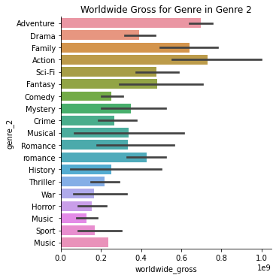
Analysis - Genre 2
Action generates the most worldwide gross revenue here, with Adventure being a very close second
Since these are both very common co-genres, they are very very close at the top.

Slide 17
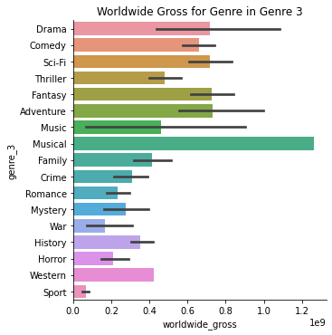
Analysis - Genre 3
Musical movies generated the most worldwide gross revenue, with Fantasy movies coming in second place.

Slide 18
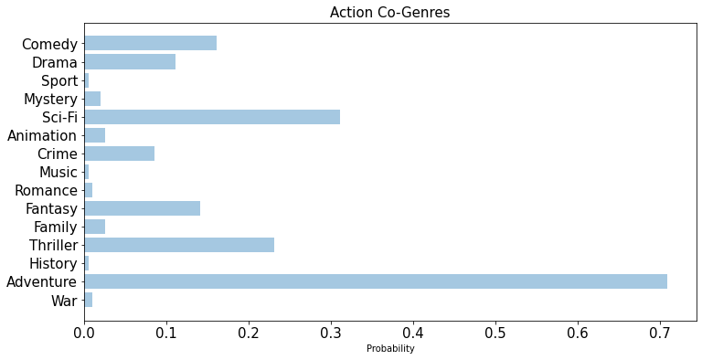
Analysis - Action Co-Genres
Adventure has the highest probability of being a co-genre to Action by a very large margin (about 40%)
Sci-Fi is second, and the next few are quite close. HoIver, it seems Music and Action are very rarely co-genres

Slide 19
Multiple Linear Regression - Data Preparation
I applied Multiple Linear Regression to the dataset to understand significant variables in predicting Worldwide gross.
In this model, I omitted some object variable such as film_title, domestic_distributor. I also changed mpaa_rating, and genre_1 into dummy variables.
To reduce the number of highly correlated variables, I used the Variance Inflation Factor (VIF) method, a measure of how much a particular variable is contributing to the standard error in the regression model, to identify and remove these. Finally, I performed stepwise selection to select the most important features for regression.

Slide 20
Multiple Linear Regression- Result Present
In our Multiple Linear Regression with Worldwide_gross as the dependent variable, I split 20% of the data into the testing dataset and 80% of the data into the training dataset.
Variable | Coefficient | P-value
release_year | 1.018e+07 | 0.00
rank_in_year | -1.993e+07 | 0.00
film_budget | 0.5004 | 0.001
length_in_min | 8.744e+05 | 0.004
domestic_gross | 1.6376 | 0.00

Slide 21
Multiple Linear Regression – Result Continued & Limitation
For the model I got R-squared 0.903 and Adj. R-squared 0.901
I Ire able to produce an optimal MSE, MAE, and RMSE values of 7.12e+15, 6.42e+07, 8.44e+07
Limitation
The Model Skew equal to 2.386 and the kurtosis equal to 18.514 indicate the data set is not normal distributed.

Slide 22
Conclusion
Based on the results from my regression model, the most important variables that influence worldwide gross are: Release year, Rank in year, Film budget, Length in min, and Domestic gross. Several of these variables, such as release year and domestic gross, are of lesser importance - the release year cannot be controlled to a high degree and the domestic gross is part of the worldwide gross. Thus, from my analysis I can conclude that the most important variables in consideration of worldwide gross are a film’s budget and its length in minutes.

Slide 23
Limitation and Future Scope
The analysis is limited by the amount of movies analysed. For instance, the database I have used does not include a sizeable number of movies that have been released, only containing ten successful movies from each year in the given range of 1977 to 2019. Further, only a single popular rating metric, imdb ratings, is present in the dataset. For more appreciable analysis of movies using critical and public reception, rather than just worldwide gross, I would need to aggregate rating scores from other sources, such as Rotten Tomato. Such data acquisition and then further analysis would be a topic of future work.

Slide 24
Thank You

